Slide 1

CSE310: Programming in Java
Fundamentals of Programming in Java

Slide 2
Naming Conventions
Use lowercase for variables and methods. If a name consists of several words, concatenate them into one, making the first word lowercase and capitalizing the first letter of each subsequent word—for example, the variables radius and area and the method print.
Capitalize the first letter of each word in a class name—for example, the class names : ComputeArea and System.
Capitalize every letter in a constant, and use underscores between words—for example, the constants PI and MAX_VALUE.
It is important to follow the naming conventions to make your programs easy to read.

Slide 3
Identifiers
A name in a program is called an identifier.
Identifiers can be used to denote classes, methods, variables, and labels.
An identifier may be any descriptive sequence of uppercase and lowercase letters, numbers, or the underscore and dollar-sign characters.
An identifier must start with a letter, an underscore (_), or a dollar sign ($). It cannot start with a digit.
Example: number, Number, sum_$, bingo, $$_100

Slide 4
Keywords
Keywords are reserved identifiers that are predefined in the language.
Cannot be used as names for a variable, class, or method.
All the keywords are in lowercase.
There are 50 keywords currently defined in the Java language.
The keywords const and goto are reserved but not used.
true, false, and null are also reserved.

Slide 5
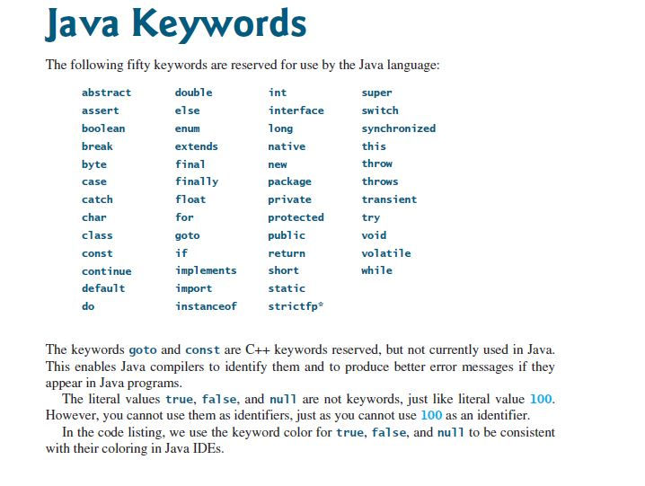

Slide 6
Numeric literals
A literal is a constant value that appears directly in a program.
Integer literals(2,98,-45 etc.)
Floating point literals(2.34f,4.675d)
Scientific notations(1.2345e2,1.5678e-2)

Slide 7
Other literals
Boolean literals: true and false
Character literals: Always enclosed in single quotes, e.g. ‘A’, ’@’
String literals: Always enclosed in double quotes
““,e.g. “Programming”, “Hello”

Slide 8
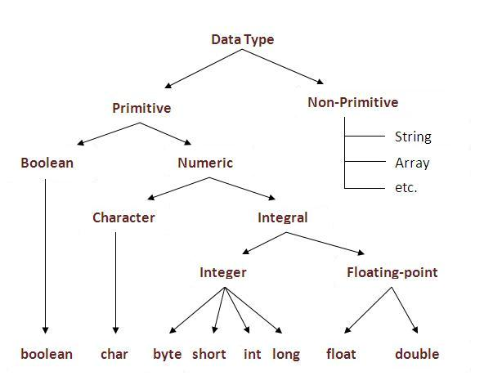

Data types in Java

Slide 9
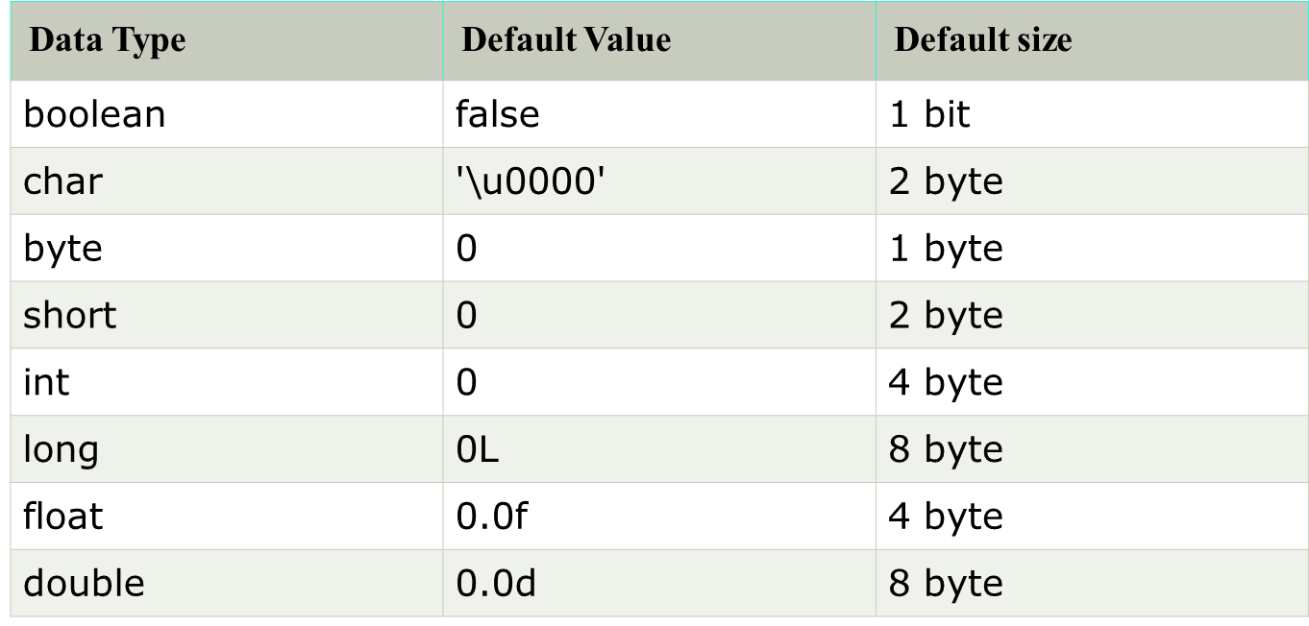
Storage size and default values

Slide 10
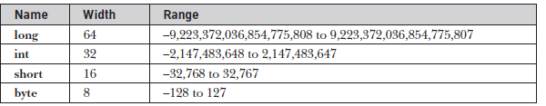

Ranges
Integers:
Floating-point types:

Slide 11
Ranges
Character:
Java uses Unicode to represent characters
Unicode defines a fully international character set that can represent all of the characters found in all human languages.
At the time of Java's creation, Unicode required 16 bits. Thus, in Java char is a 16-bit type. The range of a char is 0 to 65,536.

Slide 12
Type conversion and Casting
It is fairly common to assign a value of one type to a variable of another type. If the two types are compatible, then Java will perform the conversion automatically.
When one type of data is assigned to another type of variable, an automatic type conversion will take place if the following two conditions are met:
• The two types are compatible.
• The destination type is larger than the source type.
When these two conditions are met, a widening conversion takes place. For example, the int type is always large enough to hold all valid byte values, so no explicit cast statement is required.
if we try to assign int typed value(larger ranged value) to byte(smaller ranged value), error would arise.[As here we are doing wrong assignment, so java compiler will not perform narrowing automatically]
If we want to perform narrowing, we need to use explicit type casting

Slide 13

More points
In java the numeric data types are compatible with each other but no automatic conversion is supported from numeric type to char or boolean. Also, char and boolean are not compatible with each other.

Slide 14
Examples: Type conversion and casting
Example 1:
byte x=123;
int y=x;[Widening-Type conversion]//No error
Example 2:
int y=123;
byte x=y;[Error-Incompatible types]
Example 3:
int y=123;
byte x=(int)y;[Narrowing-Using cast expression]//No error

Slide 15
Automatic type promotions in java
Java defines several type promotion rules that apply to expressions. They are as follows:
First, all byte, short, and char values are promoted to int, as just described.
Then, if one operand is a long, the whole expression is promoted to long.
If one operand is a float, the entire expression is promoted to float.
If any of the operands are double, the result is double.

Slide 16
Example-Type promotion
public class Promote {
public static void main(String args[]) {
byte b = 42;
char c = 'a';
short s = 1024;
int i = 50000;
float f = 5.67f;
double d = .1234;
double result = (f * b) + (i / c) - (d * s);
System.out.println((f * b) + " + " + (i / c) + " - " + (d * s));
}
In the first subexpression, f * b, b is promoted to a float and the result of the subexpression
is float. Next, in the subexpression i/c, c is promoted to int, and the result is of type int.
Then, in d * s, the value of s is promoted to double, and the type of the subexpression is
double. Finally, these three intermediate values, float, int, and double, are considered. The
outcome of float plus an int is a float. Then the resultant float minus the last double is
promoted to double, which is the type for the final result of the expression.
promoted to double, which is the type for the final result of the expression.

Slide 17
Writing Your First Java Program
class MyJavaProgram
{
public static void main(String args[])
    {
    System.out.println(“Have fun in Java…”);
    }
}

Slide 18
Understanding first java program
Let's see what is the meaning of class, public, static, void, main, String[], System.out.println().
class keyword is used to declare a class in java.
public keyword is an access modifier which represents visibility, it means it is visible to all.
static is a keyword, if we declare any method as static, it is known as static method. The core advantage of static method is that there is no need to create object to invoke the static method. The main method is executed by the JVM, so it doesn't require to create object to invoke the main method. So it saves memory.
void is the return type of the method, it means it doesn't return any value.
main represents startup of the program.
String[] args is used for command line argument.
System.out.println() is used print statement.

Slide 19
System.out.println is a Java statement that prints the argument passed, into the System.out which is generally stdout.
System is a Class
out is a Static Member Field
println() is a method
System is a class in the java.lang package . The out is a static member of the System class, and is an instance of java.io.PrintStream . The println is a method of java.io.PrintStream. This method is overloaded to print message to output destination, which is typically a console or file.
class System {
public static final PrintStream out;
//...
}
the System class belongs to java.lang package
class PrintStream{
public void println();
//...
}
the Prinstream class belongs to java.io package

Slide 20
Compiling and Executing Java Program
Step-1: Save your file with .java extension.
Example: Program1.java
NOTE: If the class is public then the file name MUST BE same as the name of the class.
Step-2: Compile your .Java file using javac compiler from the location where the file is saved.
javac Program1.java

Slide 21
Compiling and Executing Java Program
Step-3: Execute your java class which contains the following method: public static void main(String args[]) {}
java MyJavaProgram

Slide 22
Q1
Which of the following is an invalid identifier?
$abc
_abc
abc_pqr
#abc

Slide 23
Q2
Which of the following is valid identifier name?
abc#pqr
1abc
a$b
@abc

Slide 24
Q3
What will be the output of following code?
public class abc2
{
public static void main(String[] args)
{
long x=123;
int y=x;
System.out.println(y);
}
}
123
123000
Compile time error
0

Slide 25
Q4
What will be the output of following code?
public class abc2
{
public static void main(String[] args)
{
double x=123.56;
int y=(int)x;
System.out.println(y);
}
}
123.0
123
Compile time error
Runtime error

Slide 26
Q5
What will be the output of following code?
public class abc2
{
public static void main(String[] args)
{
byte a=127;
a++;
System.out.println(a);
}
}
128
-128
0
Compile time error

Slide 27
Q6
Output?
public class abc2
{
public static void main(String[] args)
{
char x=65;
System.out.println(x);
}
}
A
65
Garbage value
Some special character will be printed

Slide 28
What will be the output of following code?(Q7)
public class First
{
public static void main(String[] args)
{
int a=0xC;
int b=0b1111;
System.out.println(a+" "+b);
}
}
12 14
11 10
Error
12 15

Slide 29
Q8
The smallest integer type is.........and its size is.......bits.
A.short, 8
B.byte, 8
C.short, 16
D.short, 16

Slide 30
Q9
In Java,the word true is
A. A Java keyword
B. A Boolean literal
C. Same as value 1
D. Same as value 0

Slide 31
Q10
Automatic type conversion in Java takes place when
A. Two type are compatible and size of destination type is shorter than source type.
B. Two type are incompatible and size of destination type is equal of source type.
C. Two type are compatible and size of destination type is larger than source type.
D. All of the above

Slide 32
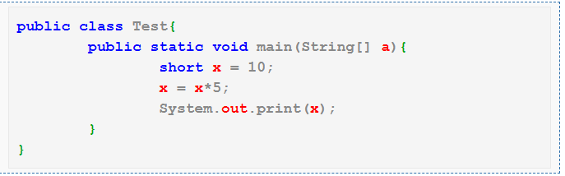
Q11
A.50
B.10
C.Compilation Error
D.None of these

Slide 33
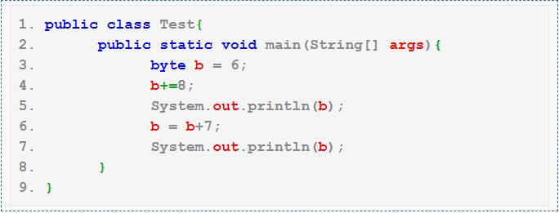
Q12
A. 14 21
B. 14 13
C. Compilation fails with an error at line 6
D. Compilation fails with an error at line 4

Slide 34


